Slide 1
SOCIETY MANAGEMENT SYSTEM
Seat No :----------
Student Name : Khan Faisal Iqbal Rizwan

Slide 2
INDEX
Scope of Project
Technology
Objectives of System
Global Use case Diagram
Class Diagram
List of Forms
List of Database-Tables
List of Reports
Drawbacks & Limitations
Conclusion

Slide 3
Scope of Project
1)Committee Member:
Login
Maintain User Type
Maintain State
Maintain District
Maintain City
Maintain Society
Master And Details
Change Password
2)Society Member:
Maintain Login
Maintain Building Registration.
Maintain Society Employee Registration.
Maintain Society Expenses
Maintain Revenue
Maintain Parking Details
Update Profile.
Change Password
View Reports

Slide 4
3)Building Member:
Maintain Login
Maintain Flat Details.
Maintain Flat Member Details.
Maintain Payment By Flat
Maintain Building Expenses
Maintain Notice Board
Update Profile.
Change Password
View Reports
4)Flat Member:
Maintain Login
View Notice Board
Make Payment.
Give Feedback.
Contact
Update Profile.
Change Password

Slide 5
Technology Used
Given below is the list of minimum recommended software:
Operating System (any one of the following)
Windows 2000.
Windows XP(Service Pack 2) Or Above
Microsoft Dot NET Framework 3.0 or above
Microsoft Visual Studio 2010
Database
MS SQL Server 2008 R2

Slide 6
Objectives of System
The existing system will be replace by modern computer technology, this system easy the work of the society on the daily basis.
It will reduce time consumption of task to be performed. All the report will generate on one click only. Automatic validation will reduced the data entry errors. Easy to use.
The purpose of this application is to provide convenience of all the member of society by enabling them to see all the bill details, receipt details, notice board details as well as respective reports can be generated depending on the requirement. This gives privilege to manage the society, building and individual flats in a well manner. In this society management system, it gives all information about society such as how many flat available in society, society admin details, flat member details etc.
In this society management system, it also involve notice board facility and all there user can view notice board.

Slide 7
Global Use case Diagram

Slide 8
Class Diagram

Slide 9
List of Database-Tables
1) Maintain User Type
Field | Type | Constraints
user_type_id | bigint | P.K
user_type | nvarchar(200)
Flag | nvarchar(5)
2) User Type Registration:-
Field | Type | Constraints
regi_id | bigint | P.K
first_name | nvarchar(100)
middle_name | nvarchar(100)
last_name | nvarchar(100)
email_id | nvarchar(100)
mobile_number | nvarchar(15)
Password | nvarchar(50)
user_type | nvarchar(100) | F.K
State | bigint
District | bigint
City | bigint | F.K

Slide 10
3)Maintain State
Field | Type | Constraints
state_id | bigint | P.K
state_name | nvarchar(150)
Flag | nvarchar(5)
4)Maintain District
Field | Type | Constraints
district_id | bigint | P.K
state_id | bigint | F.K
district_name | nvarchar(150)
Flag | nvarchar(5)
5)Maintain City
Field | Type | Constraints
city_id | bigint | P.K
district_id | bigint | F.K
city_name | nvarchar(150)
Flag | nvarchar(5)

Slide 11
6)Maintain Society Master
Field | Type | Constraints
society_id | bigint | P.K
city_id | bigint | F.K
society_name | nvarchar(100)
society_address | nvarchar(500)
society_pincode | nvarchar(6)
Flag | nvarchar(5)
7)Maintain Building Registration
Field | Type | Constraints
build_id | bigint | P.K
society_id | bigint | F.K
build_name | nvarchar(150)
build_no | nvarchar(100)
build_area | nvarchar(150)
carpet_area | nvarchar(150)
Flag | nvarchar(5)

Slide 12
8) Maintain Society Employee Registration
Field | Type | Constraints
society_emp_regi_id | bigint | P.K
society_id | bigint | F.K
build_id | bigint | F.K
emp_name | nvarchar(100)
emp_contact_no | nvarchar(100)
emp_address | nvarchar(500)
emp_acc_name | nvarchar(100)
emp_acc_no | nvarchar(100)
emp_bank_branch | nvarchar(100)
emp_work_type | nvarchar(200)
Flag | nvarchar(5)

Slide 13
9)Maintain Society Expences
Field | Type | Constraints
soci_exp_id | bigint | P.K
society_id | bigint | F.K
Expences | nvarchar(500)
exp_vendor_name | nvarchar(100)
exp_vendor_address | nvarchar(500)
payment_date | date
payment_mode | nvarchar(150)
payment_details | nvarchar(500)
exp_amount | float
exp_comment | nvarchar(600)
Flag | nvarchar(5)
10)Maintain Society Revenue
Field | Type | Constraints
soci_rev_id | bigint | P.K
society_id | bigint | F.K
rev_type | nvarchar(100)
build_id | bigint | F.K
payment_type | nvarchar(100)
Amount | float
Flag | nvarchar(5)

Slide 14
11) Maintain Parking
Field | Type | Constraints
parking_id | bigint | P.K
build_id | bigint | F.K
parking_no | nvarchar(50)
parking_type | nvarchar(50)
Flag | nvarchar(5)
12) Maintain Flat Details
Field | Type | Constraints
flat_id | bigint | P.K
flat_member_id | bigint | F.K
flat_sq_foot_area | nvarchar(200)
flat_type | nvarchar(100)
Flag | nvarchar(5)

Slide 15
13)Maintain Flat Member Details:-
Field | Type | Constraints
flat_member_id | bigint | P.K
society_id | bigint | F.K
build_id | bigint | F.K
flat_no | nvarchar(100)
flat_member_name | nvarchar(100)
flat_member_email_id | nvarchar(100)
Flag | nvarchar(5)
14) Maintain Payment By Flat
Field | Type | Constraints
payment_by_flat_id | bigint | P.K
society_id | bigint | F.K
flat_id | bigint | F.K
tenant_no | nvarchar(100)
contact_no | nvarchar(50)
agg_start_date | date
agg_end_date | date
rent_amount | float
Flag | nvarchar(5)

Slide 16
15) Maintain Building Expences
Field | Type | Constraints
build_exp_id | bigint | P.K
build_id | bigint | F.K
build_exp_type | nvarchar(100)
build_exp_amount | float
Flag | nvarchar(5)
16) Maintain Notice Board
Field | Type | Constraints
notice_board_id | bigint | P.K
build_id | bigint | F.K
society_id | bigint | F.K
Title | nvarchar(100)
Description | nvarchar(500)
notice_from_date | date
notice_to_date | date
notice_attachment | nvarchar(200)
Flag | nvarchar(5)

Slide 17
17) Make Payment
Field | Type | Constraints
flat_pay_id | bigint | P.K
flat_member_id | bigint | F.K
payment_by_flat_id | bigint | F.K
flat_expences | nvarchar(200)
Flag | nvarchar(5)
18) FeedBack
Field | Type | Constraints
feedback_id | bigint | P.K
Name | nvarchar(100)
email_id | nvarchar(100)
Message | nvarchar(500)
19)Contact
Field | Type | Constraints
contact_id | bigint | P.K
Fullname | nvarchar(100)
email_id11 | nvarchar(100)
message11 | nvarchar(500)

Slide 18
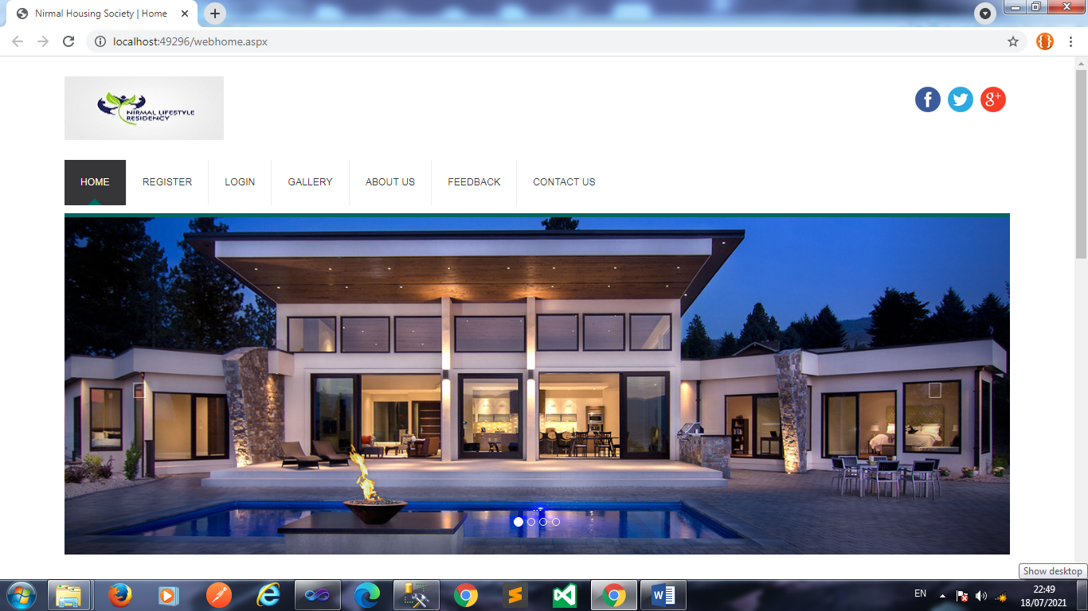
Input And Output Screens using sample data
Homepage:-
Home:-

Slide 19
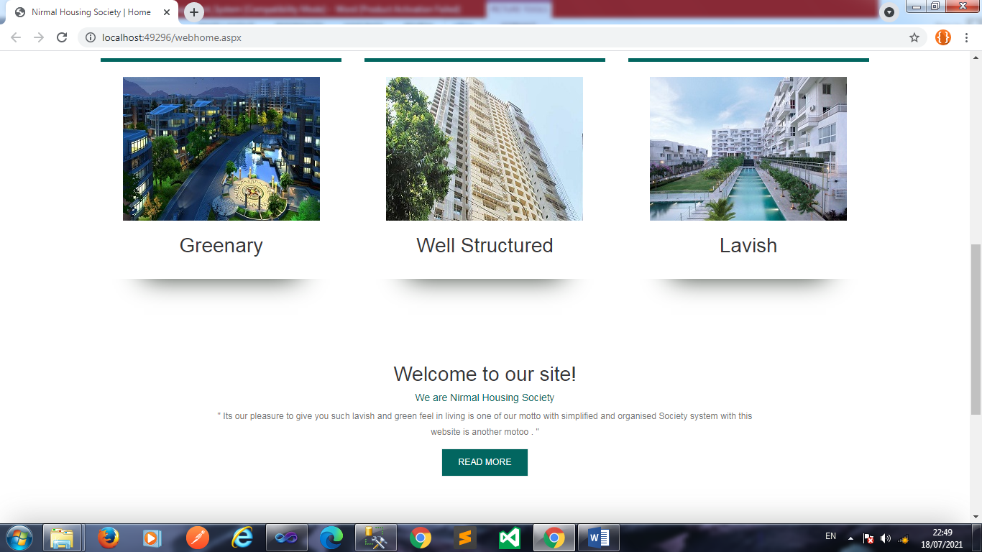

Slide 20
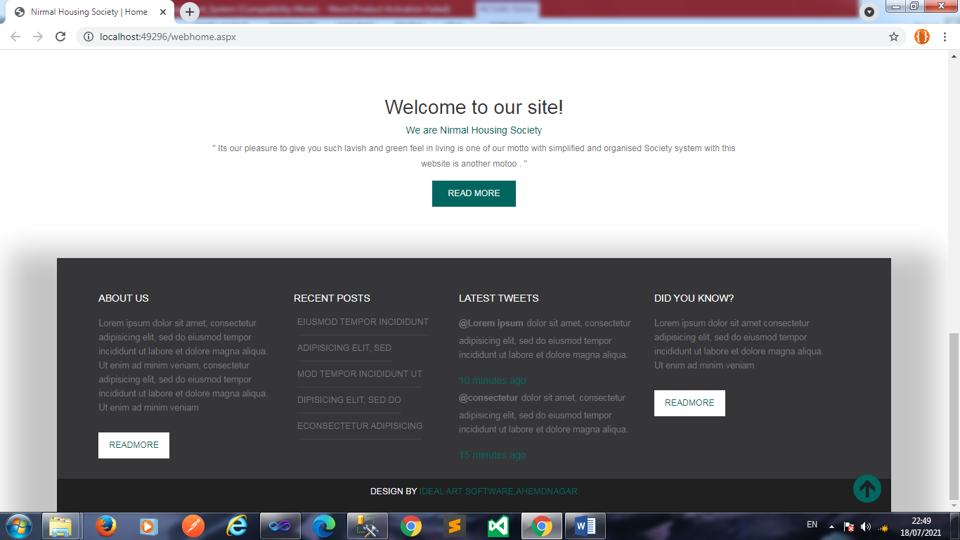

Slide 21
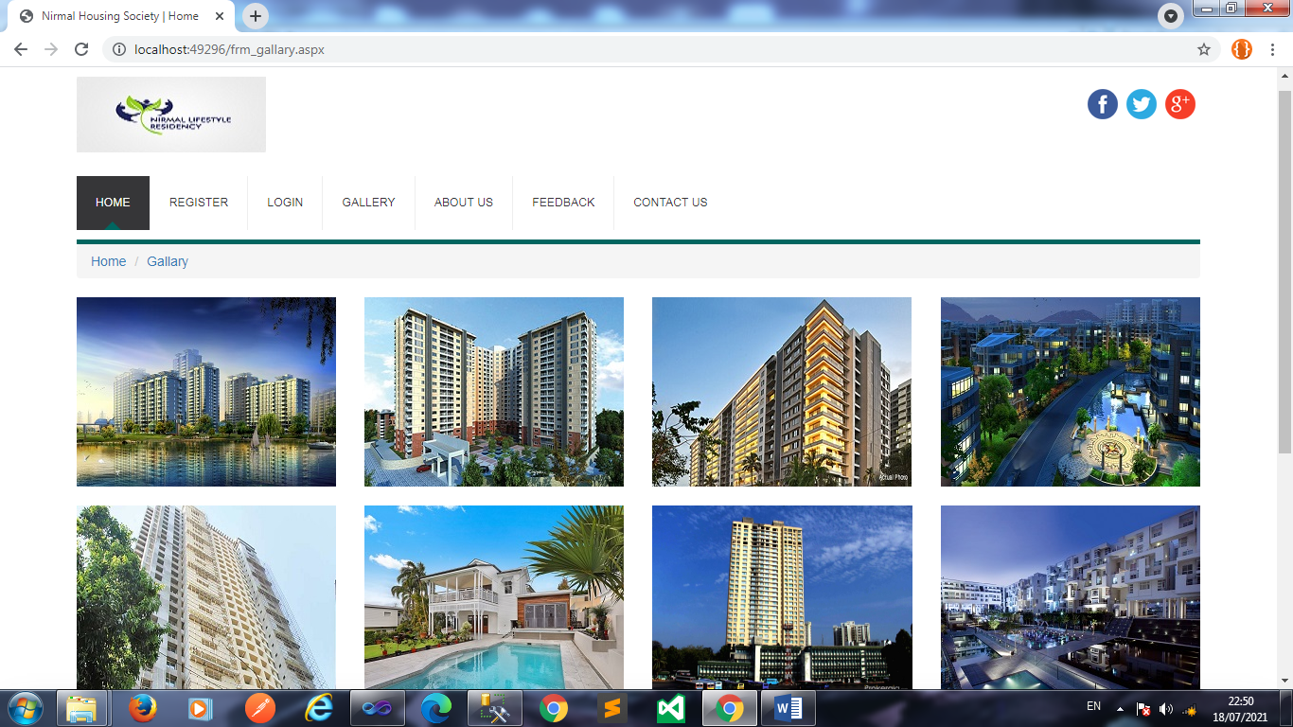
Gallery:-

Slide 22
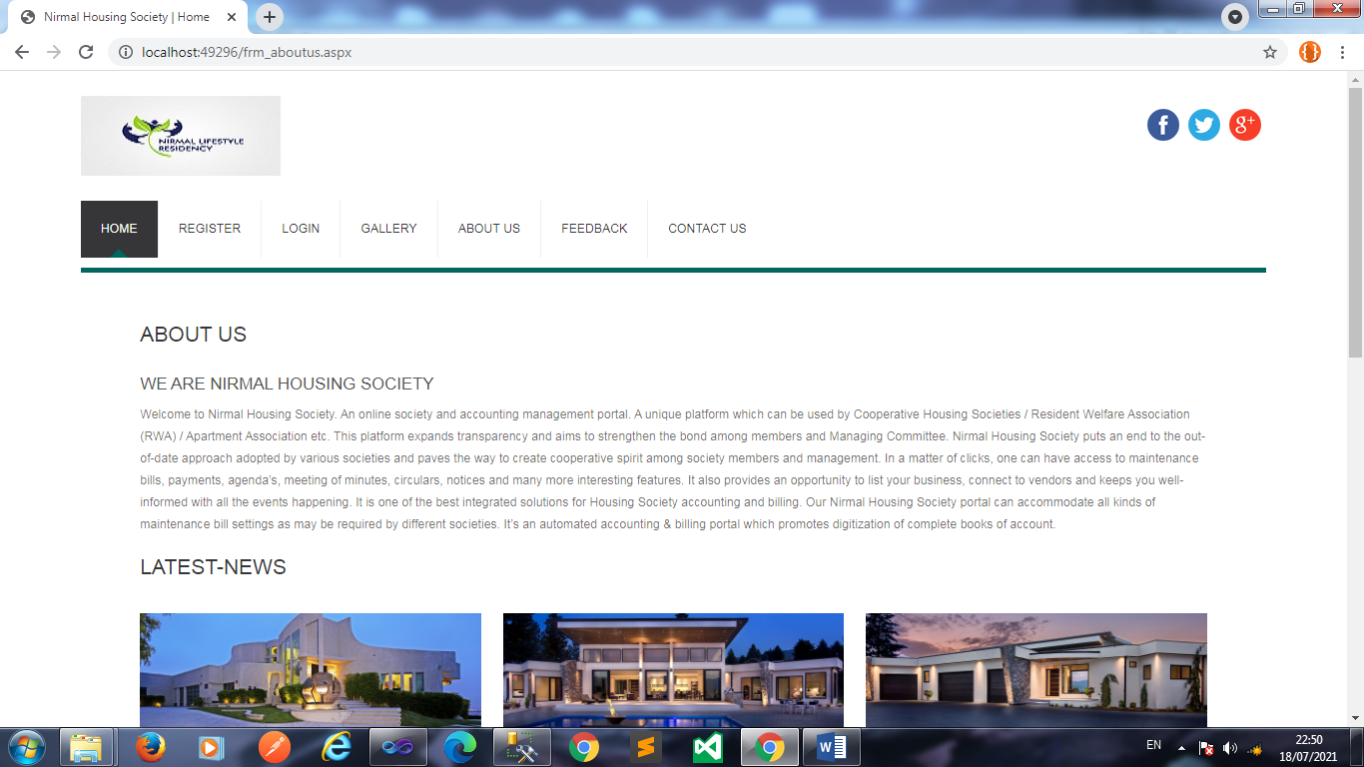
About Us:-

Slide 23
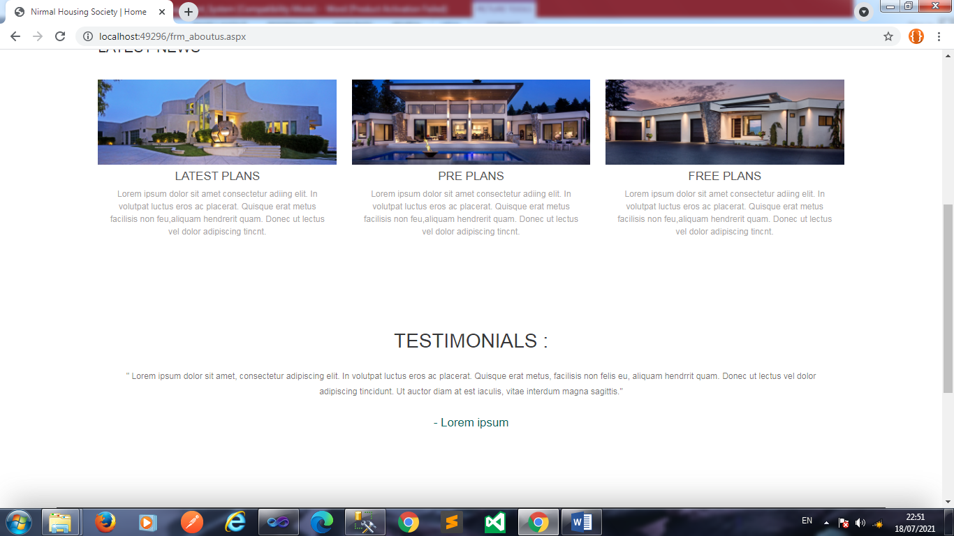

Slide 24
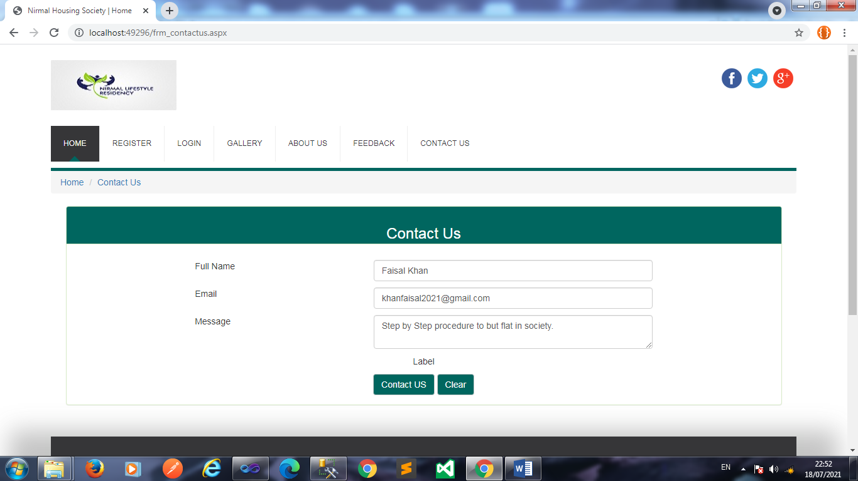
Contact Us:-

Slide 25
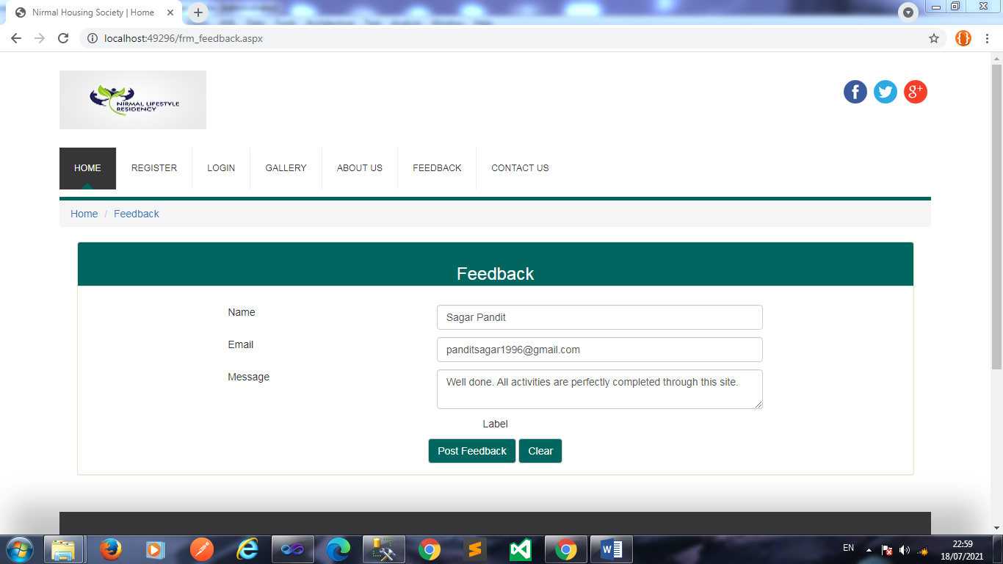
Feedback

Slide 26
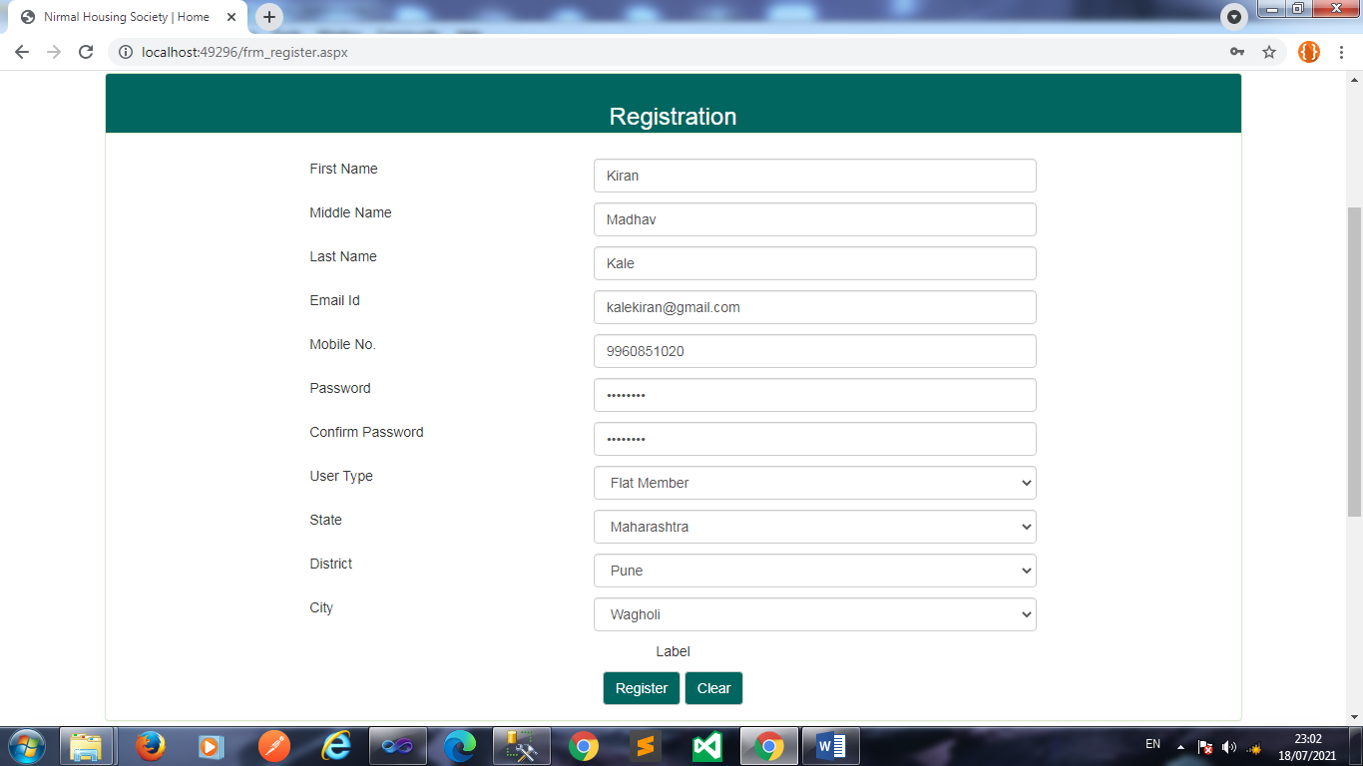
User Registration

Slide 27
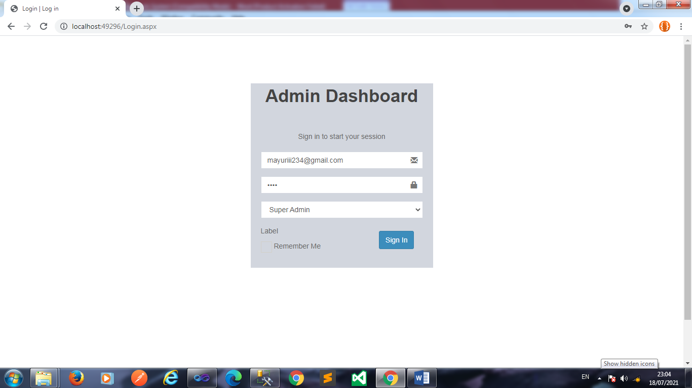
Member Login (Super Admin)

Slide 28
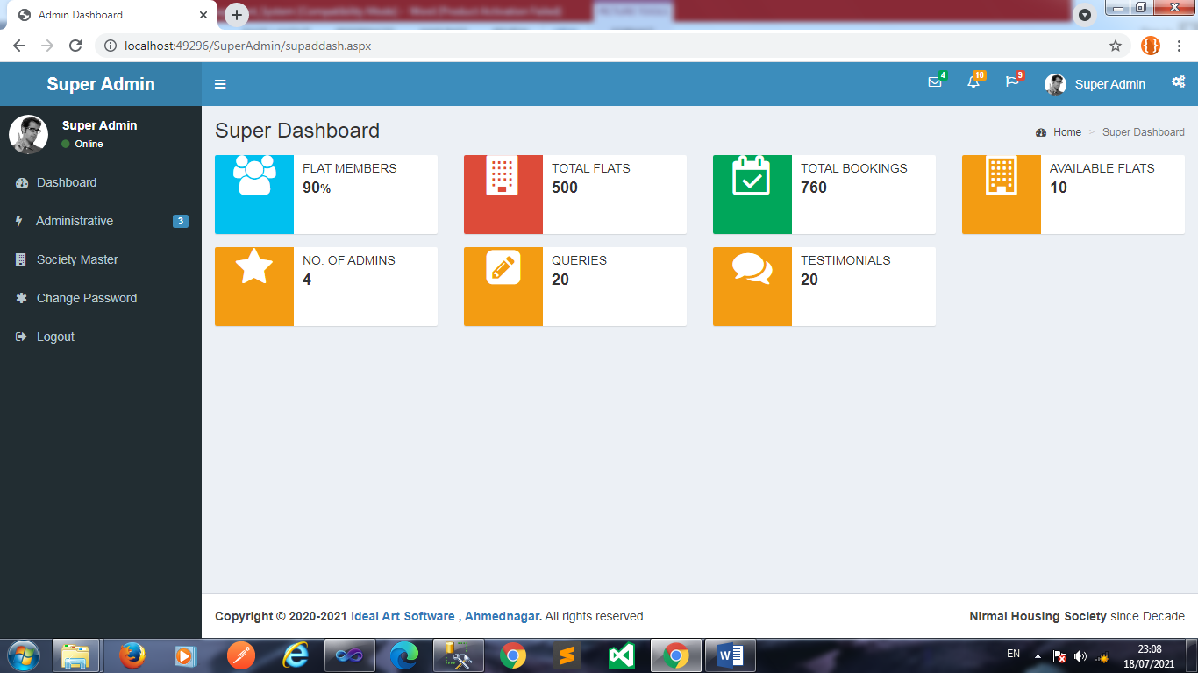
Admin Dashboard

Slide 29
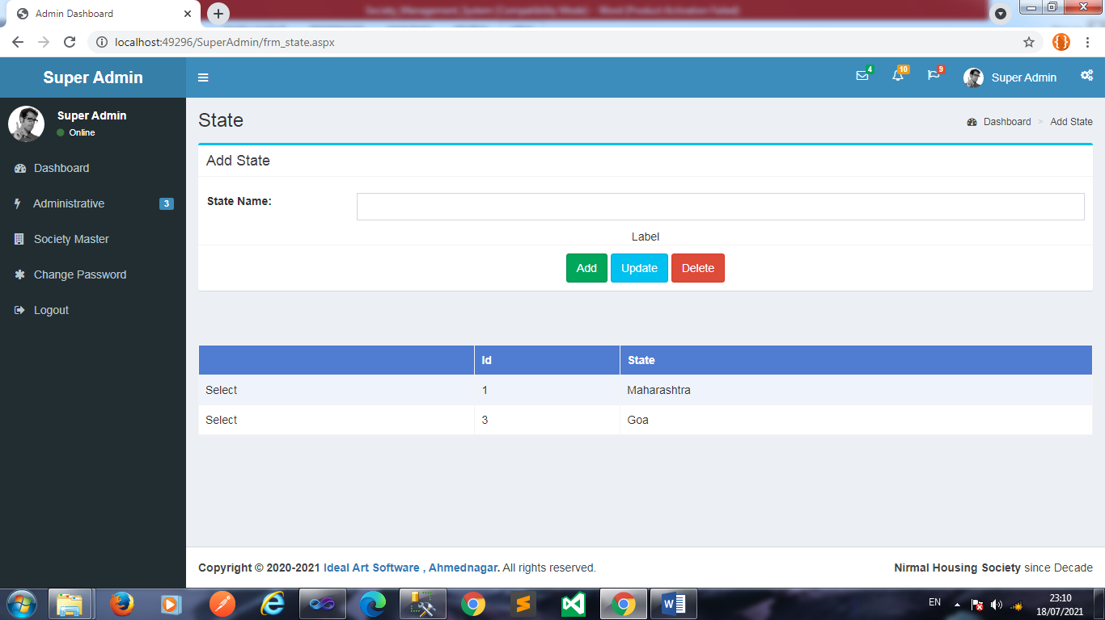
Maintain State

Slide 30
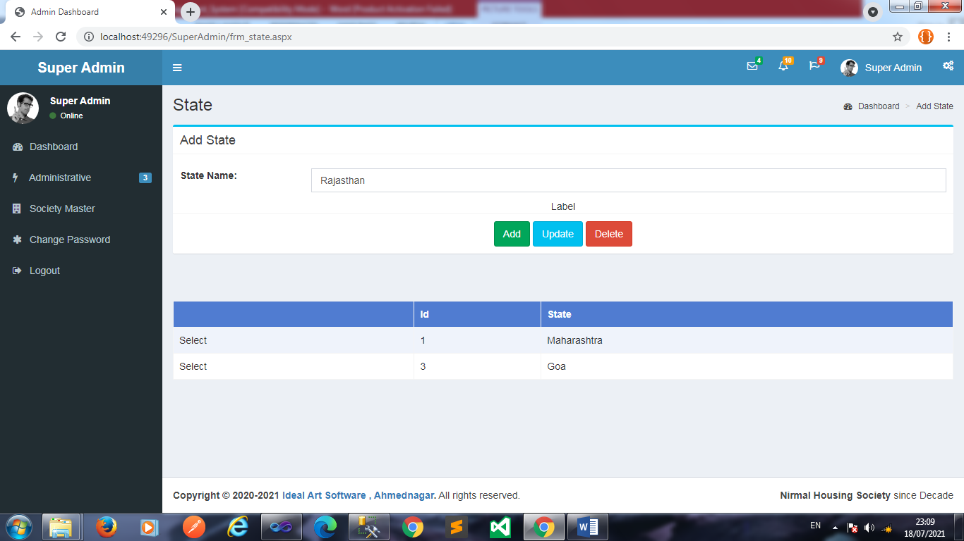
Add State

Slide 31
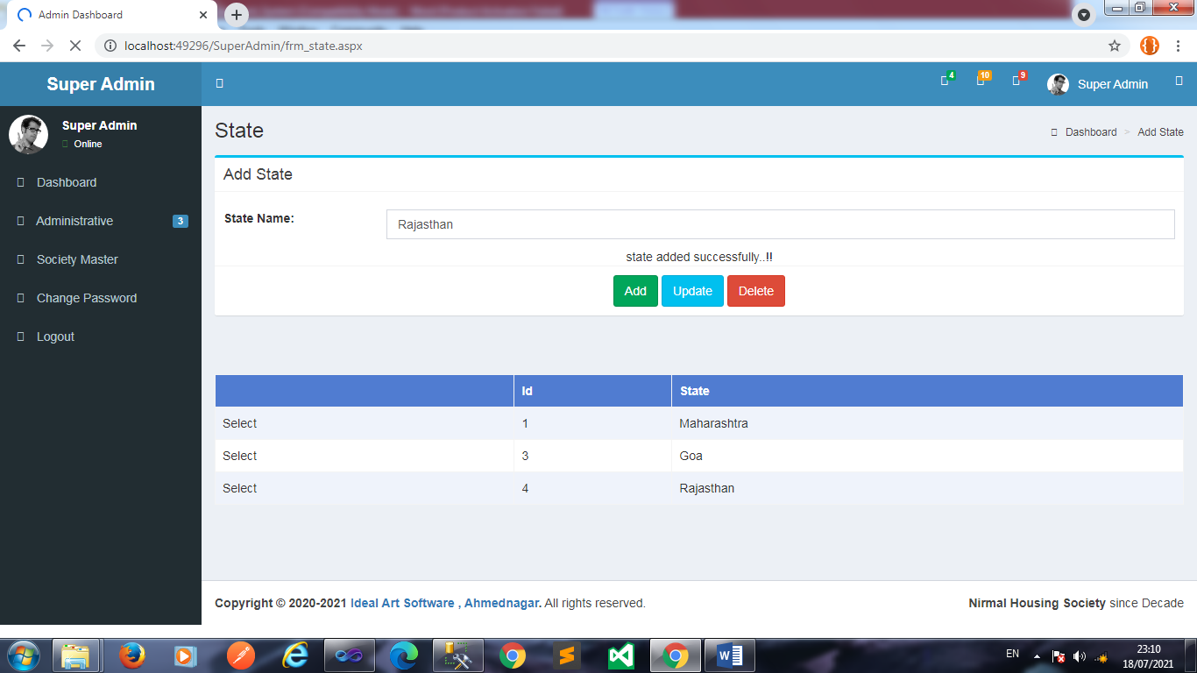

Slide 32
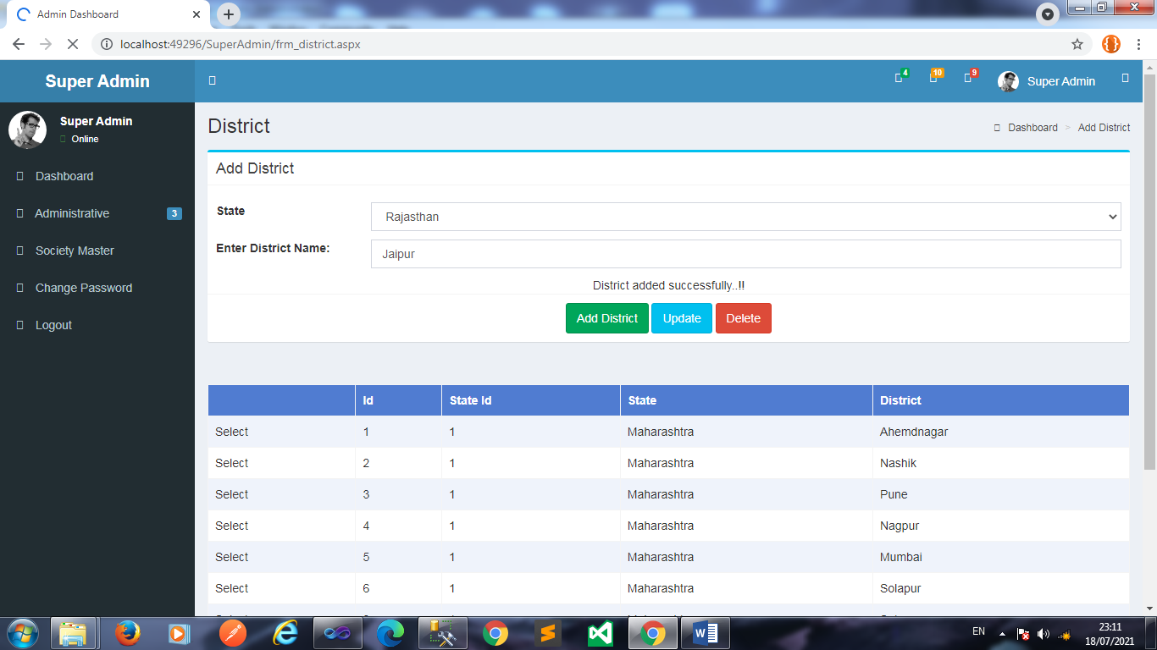
Maintain District

Slide 33
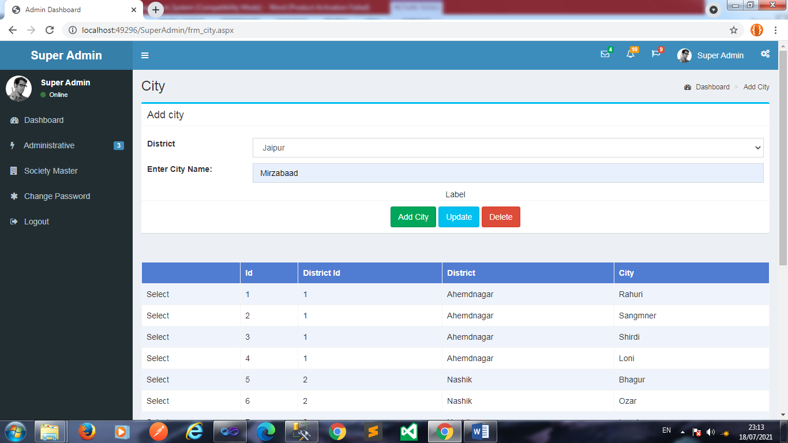
Maintain City:-

Slide 34
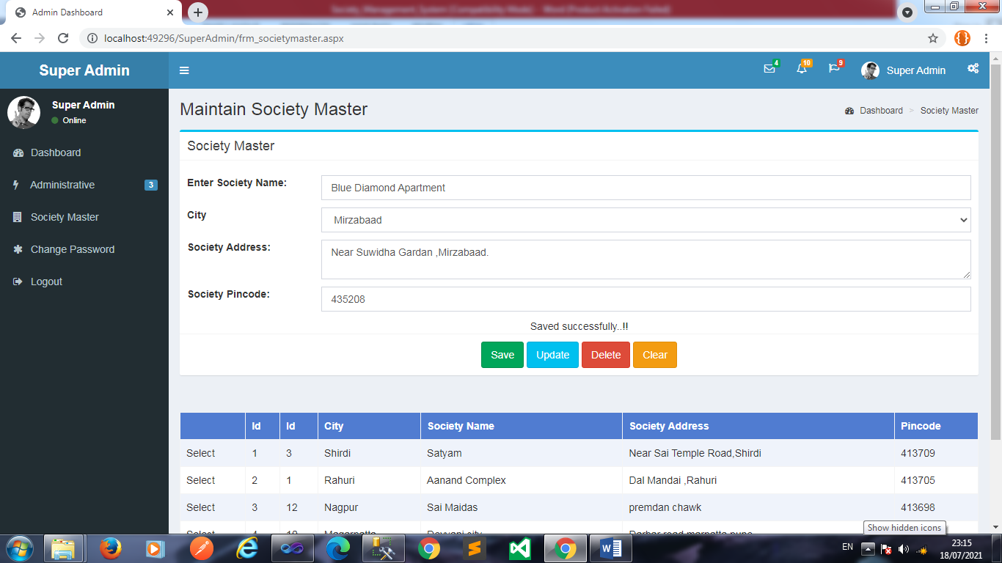
Maintain Society:

Slide 35
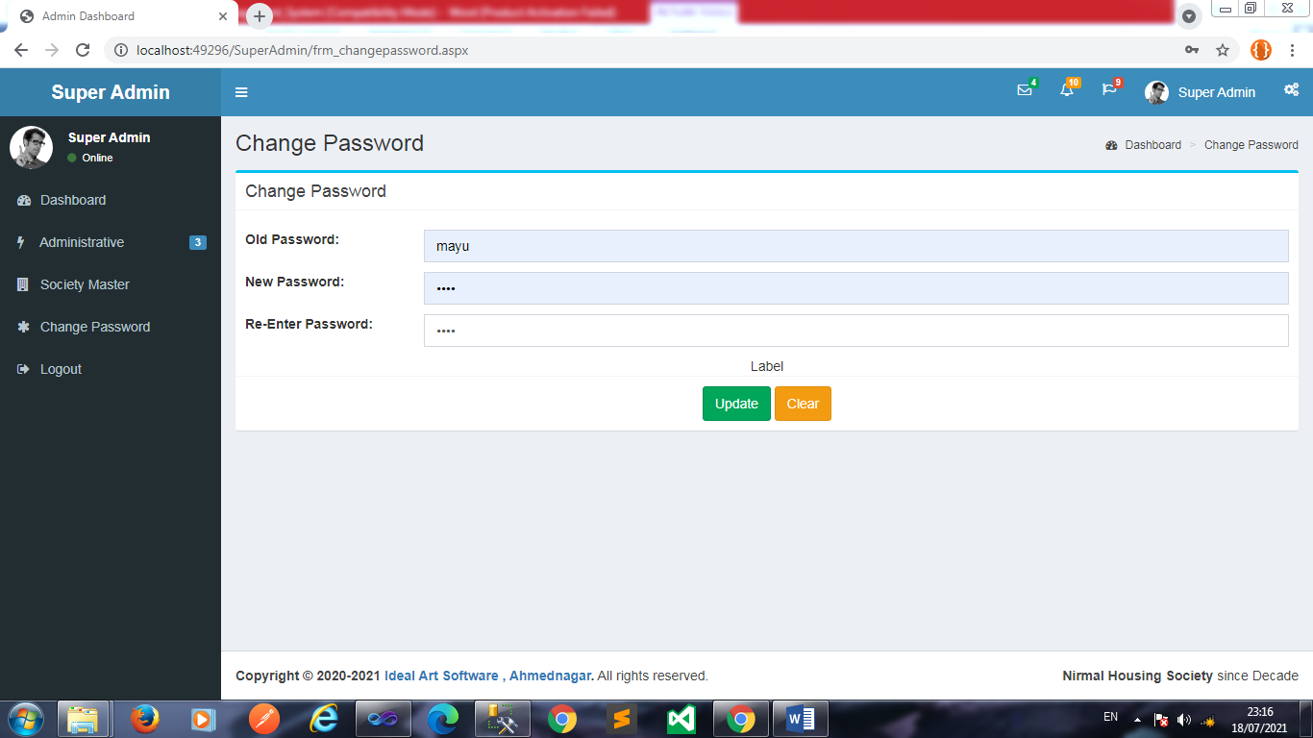
Change Password:-

Slide 36
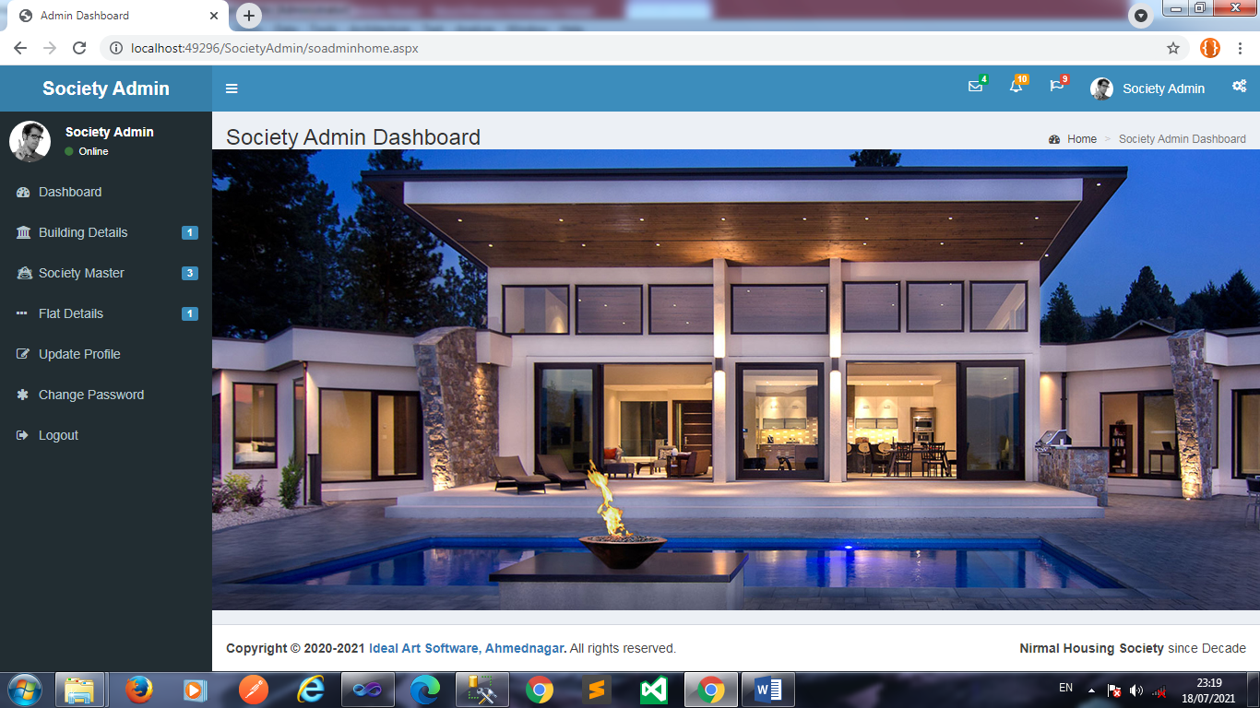
Society Admin Dashboard :-

Slide 37
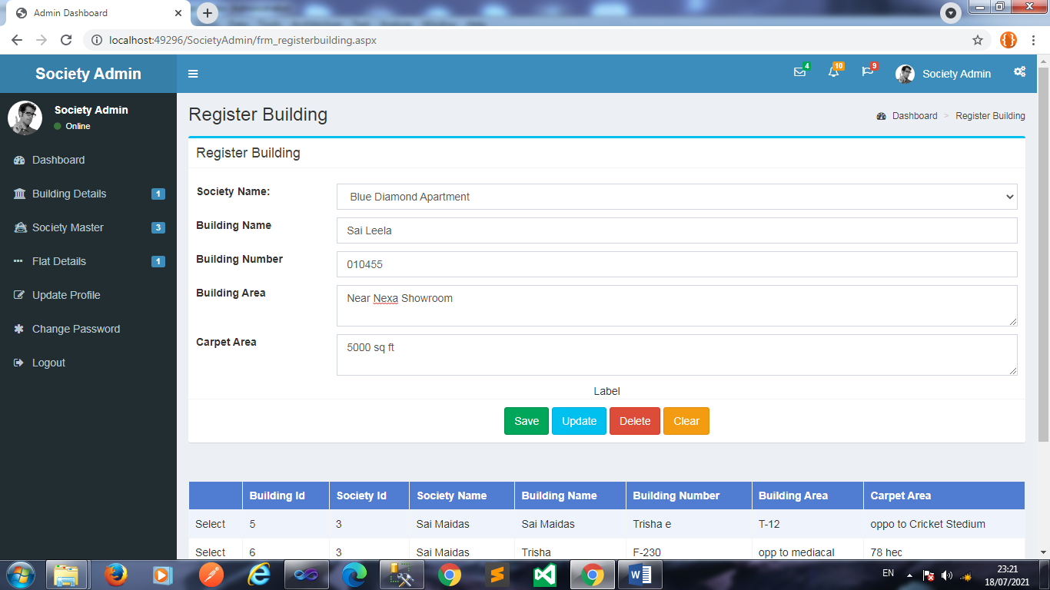
Maintain Society:-

Slide 38
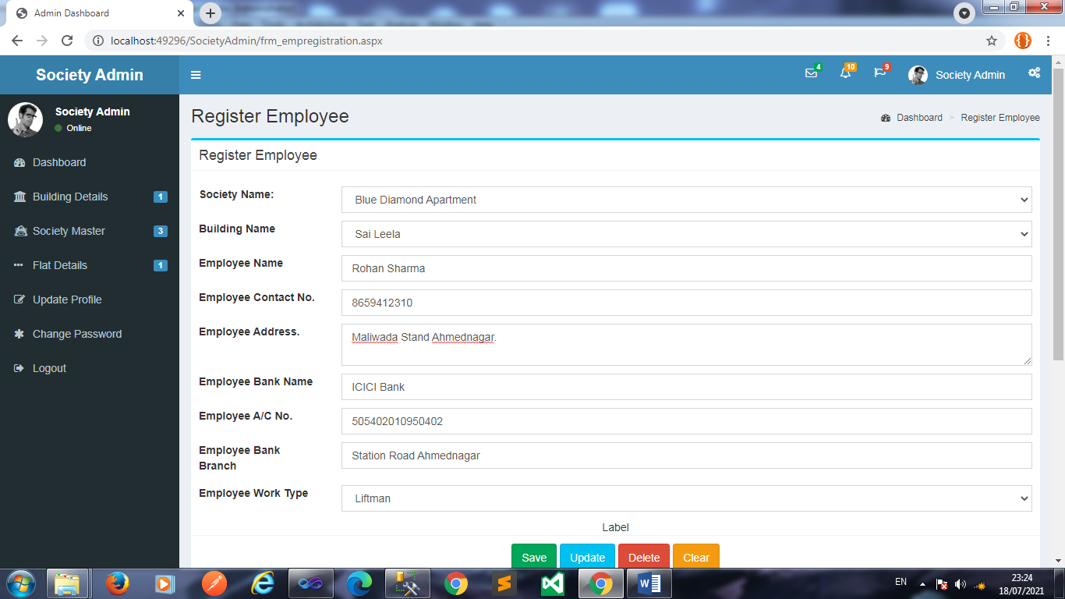
Maintain Society Employee

Slide 39

Maintain Society Expenses:-

Slide 40
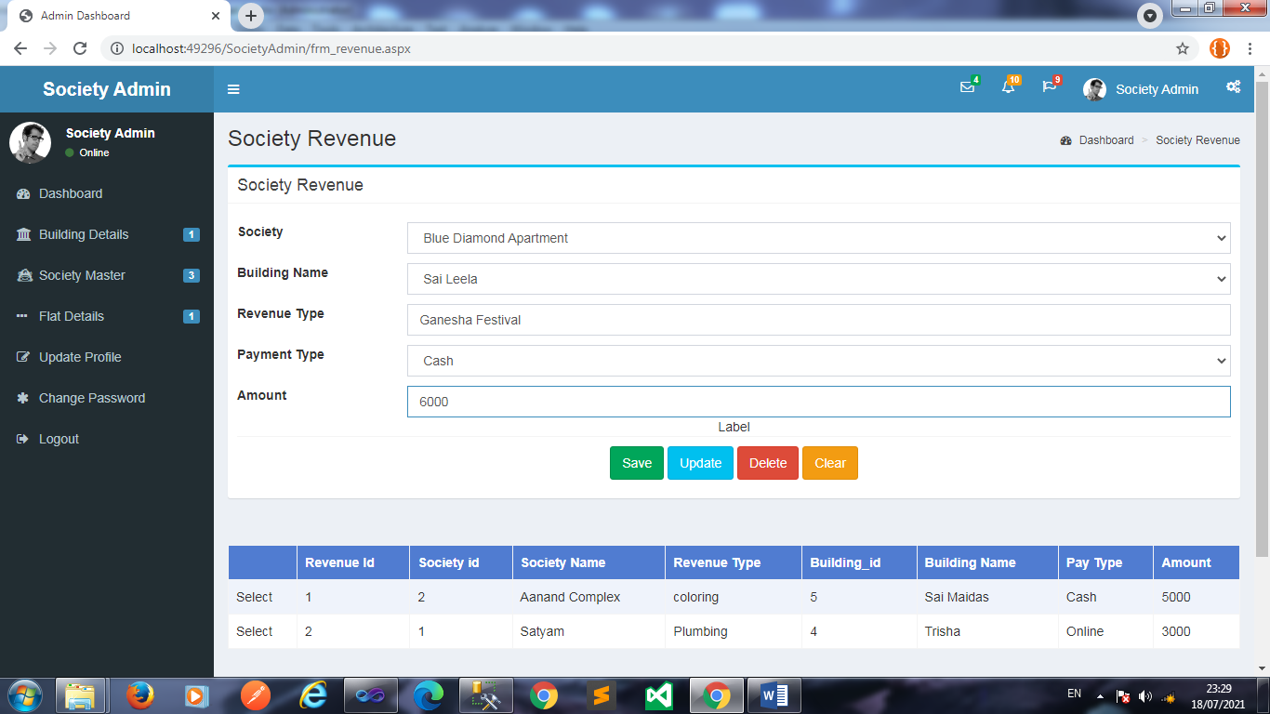
Maintain Revenue :-

Slide 41
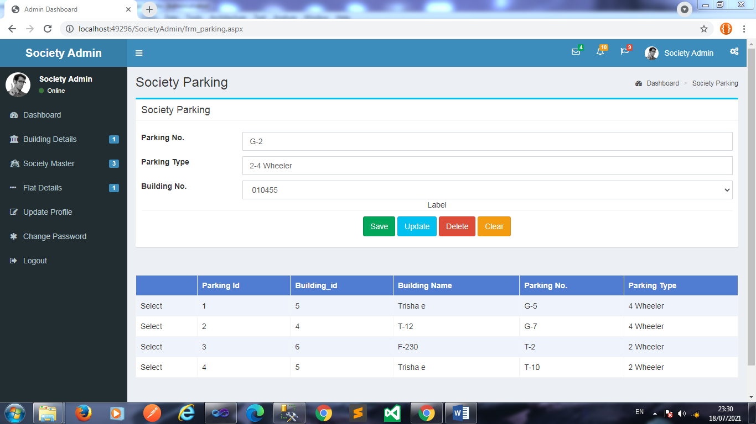
Maintain Parking :-

Slide 42
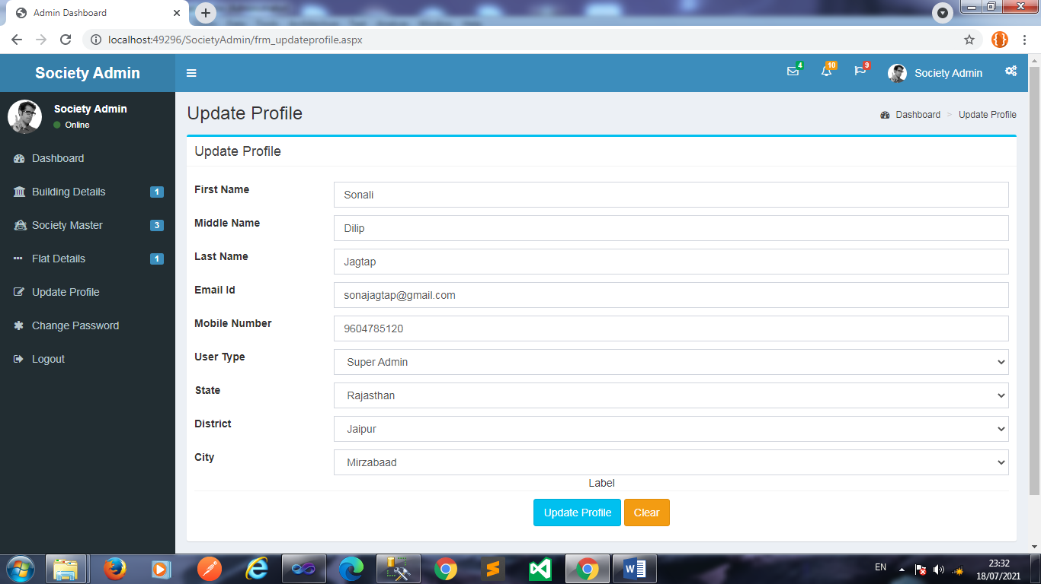
Update Parking:-

Slide 43
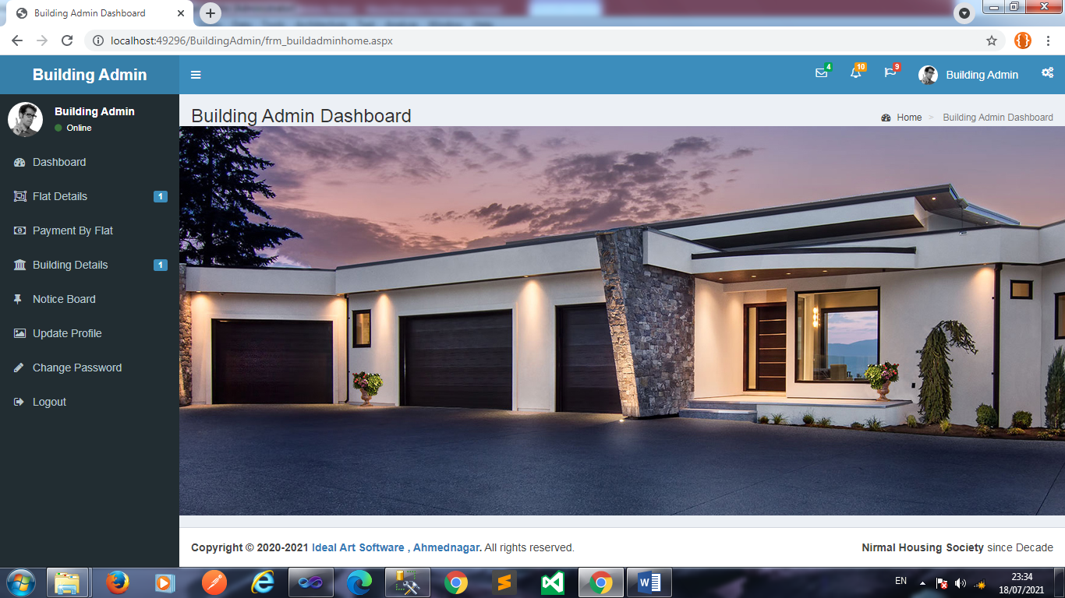
Building Admin Dashboard

Slide 44
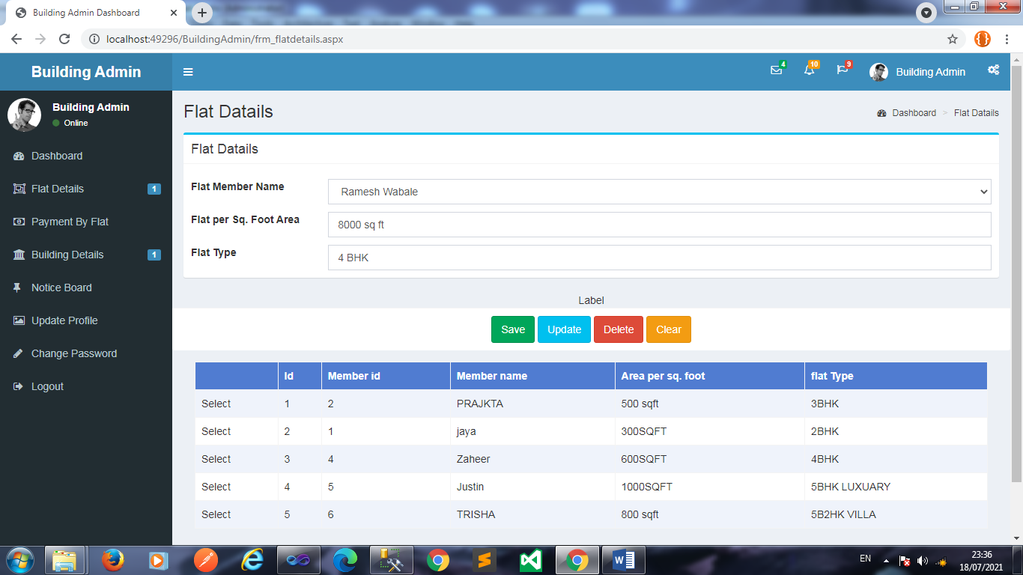
Maintain Flat Detail :

Slide 45
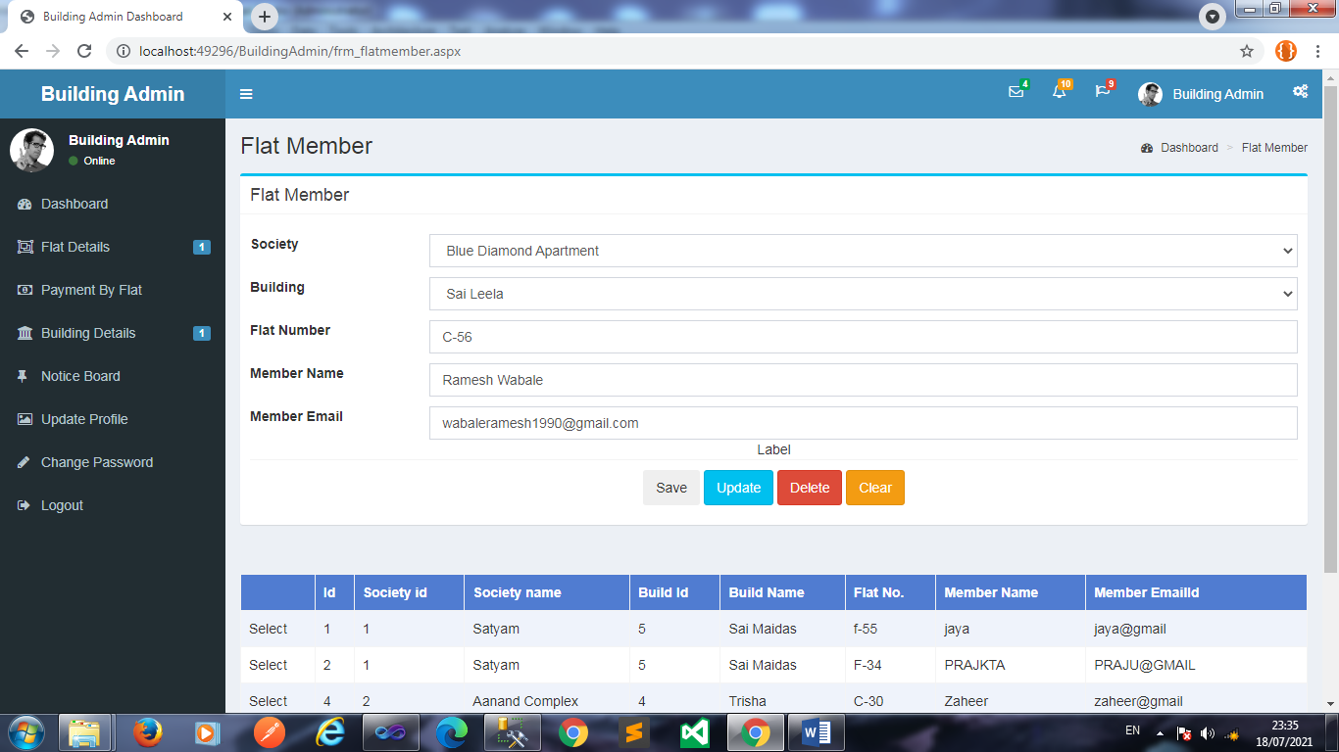
Maintain Flat Member :

Slide 46
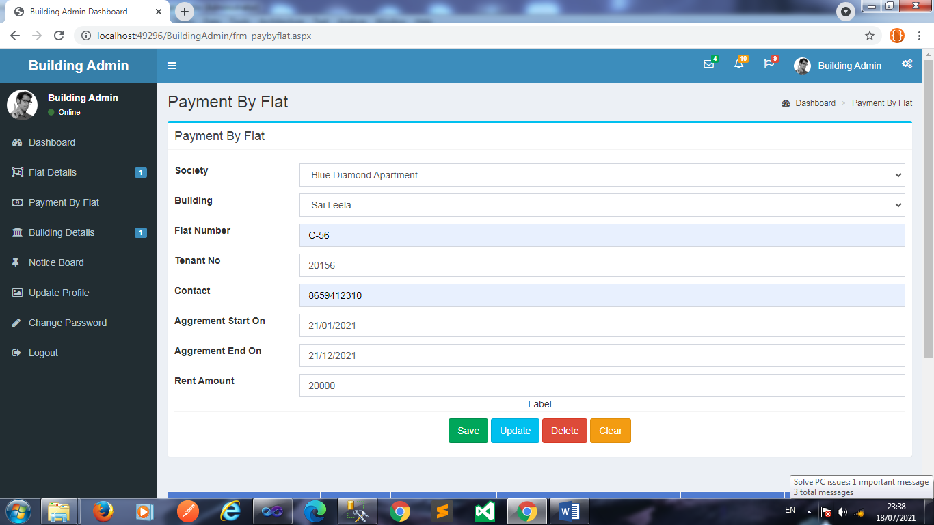
Maintain Flat Payment

Slide 47
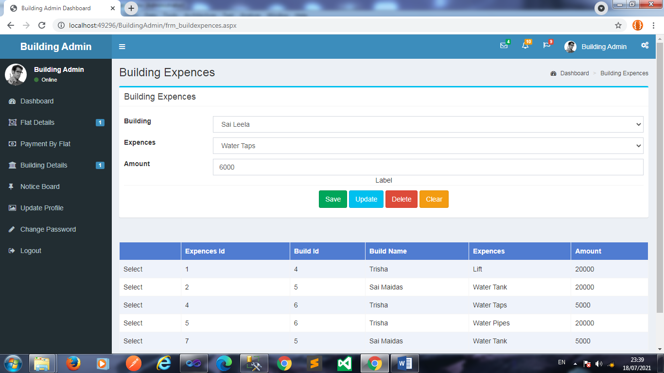
Maintain Building Expenses

Slide 48
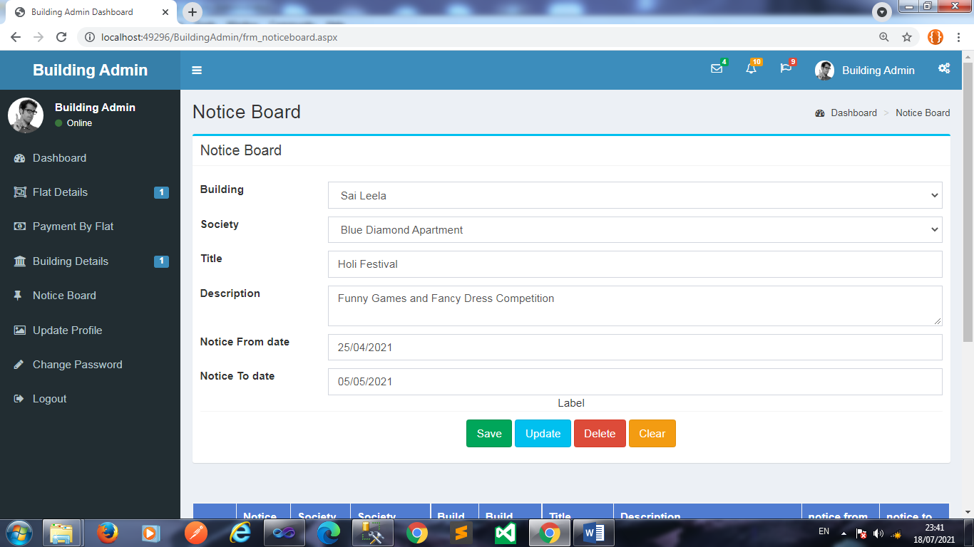
Maintain Notice Board :

Slide 49
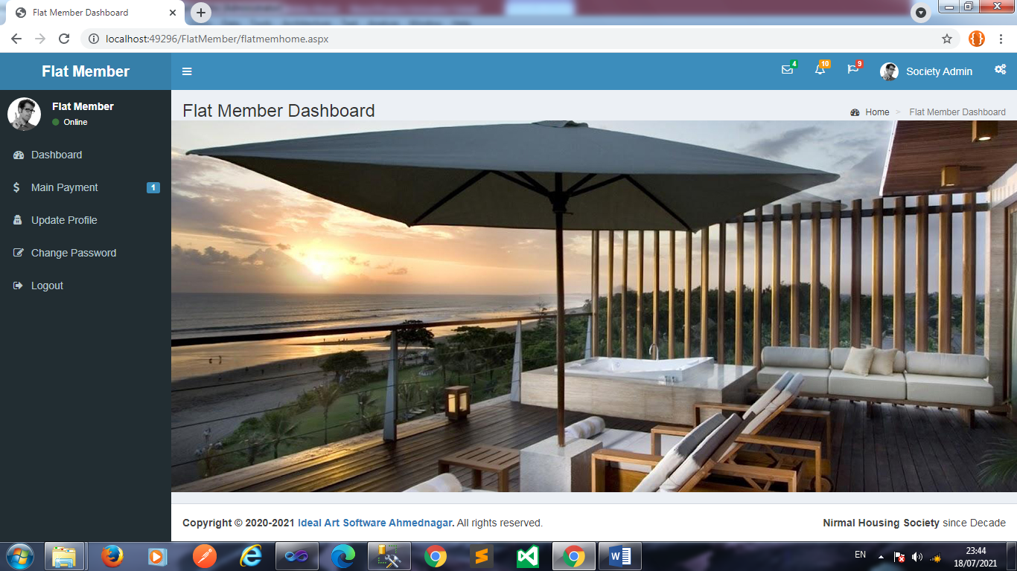
Flat Member Dashboard :

Slide 50
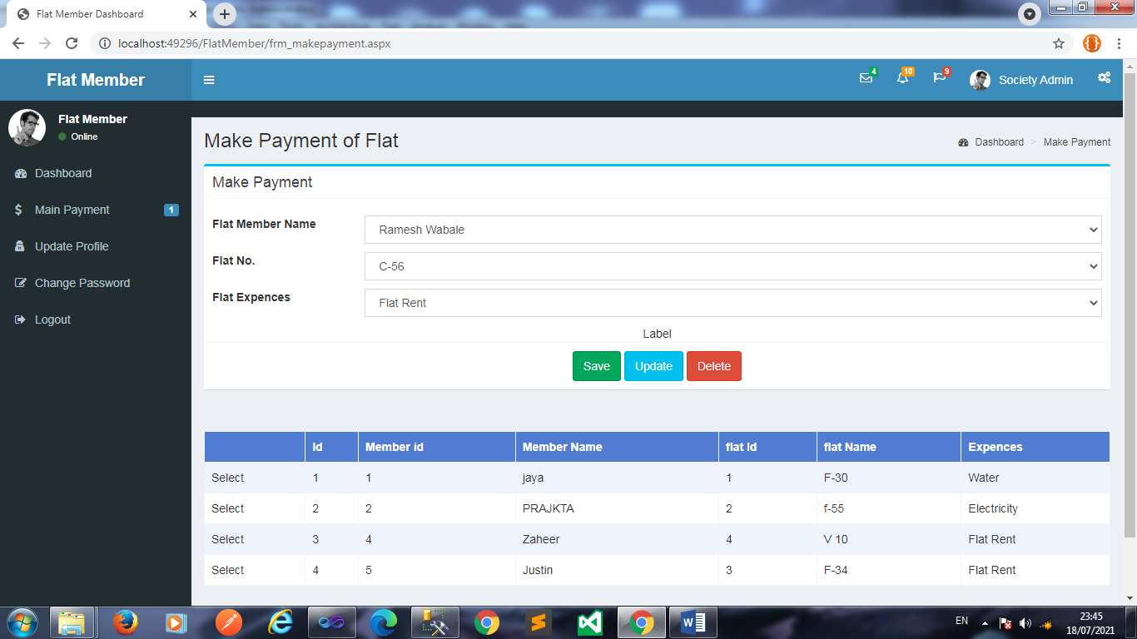
Maintain Payment :

Slide 51
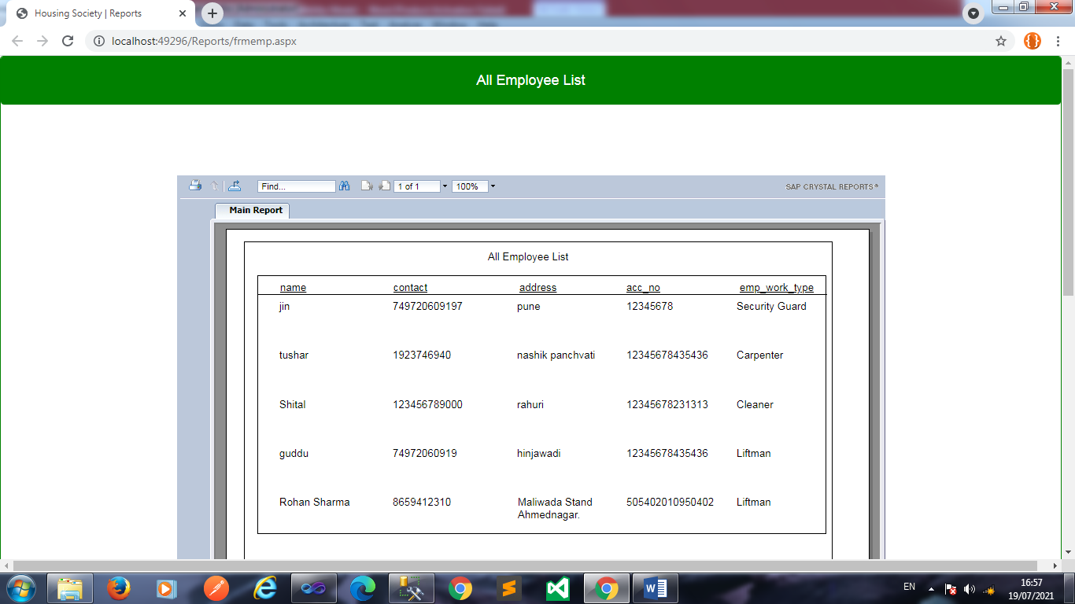
Reports View Employee :

Slide 52
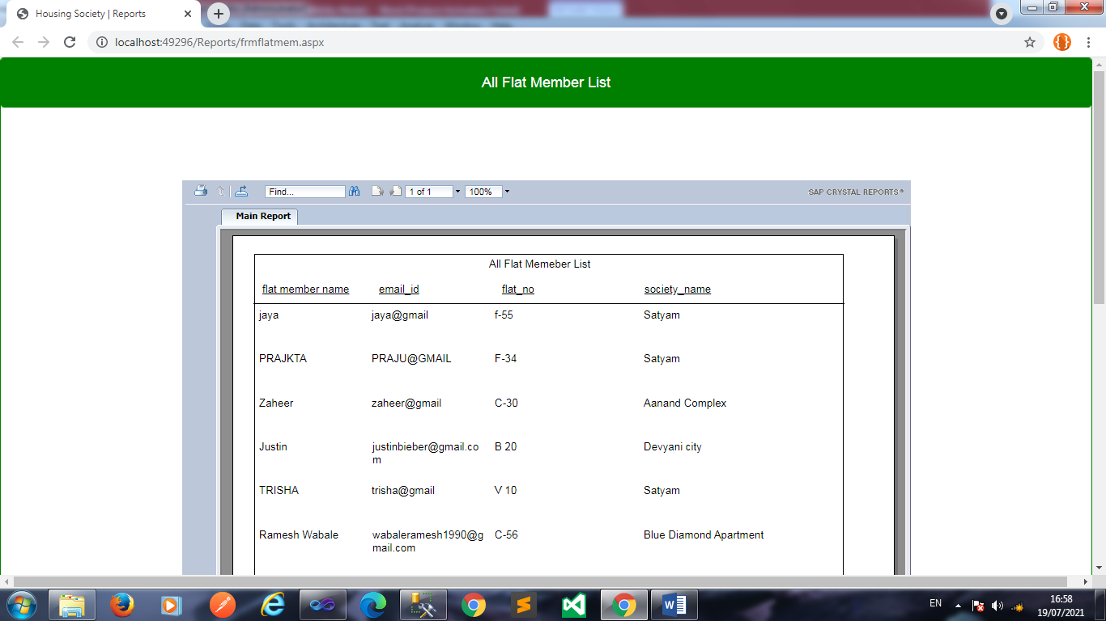
View Flat Member :

Slide 53
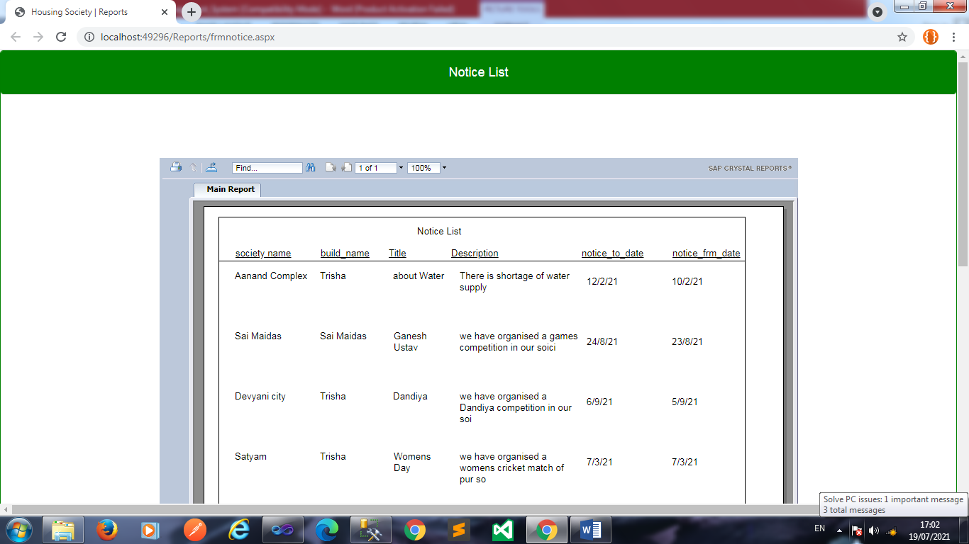
View Notice :

Slide 54
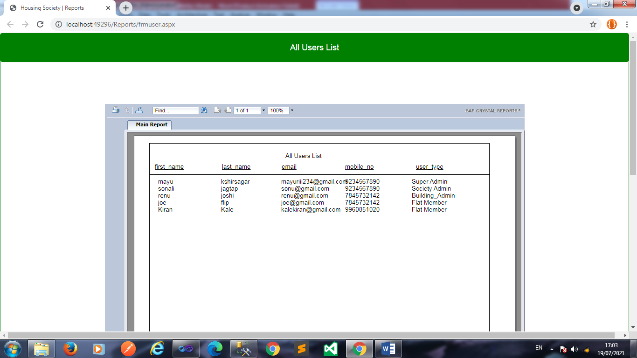
All User List :

Slide 55
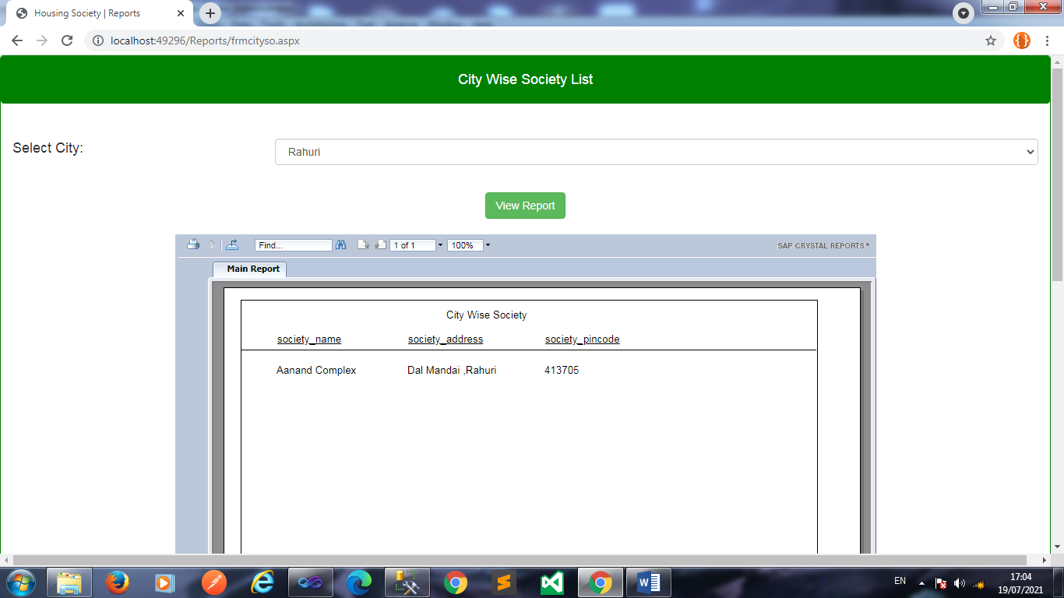
City wise Society Report

Slide 56
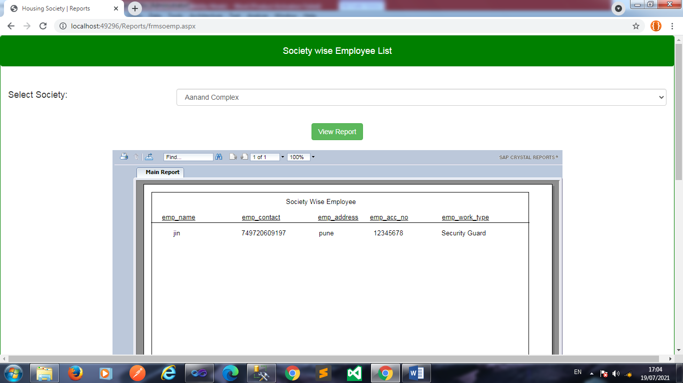
Society wise Employee List

Slide 57
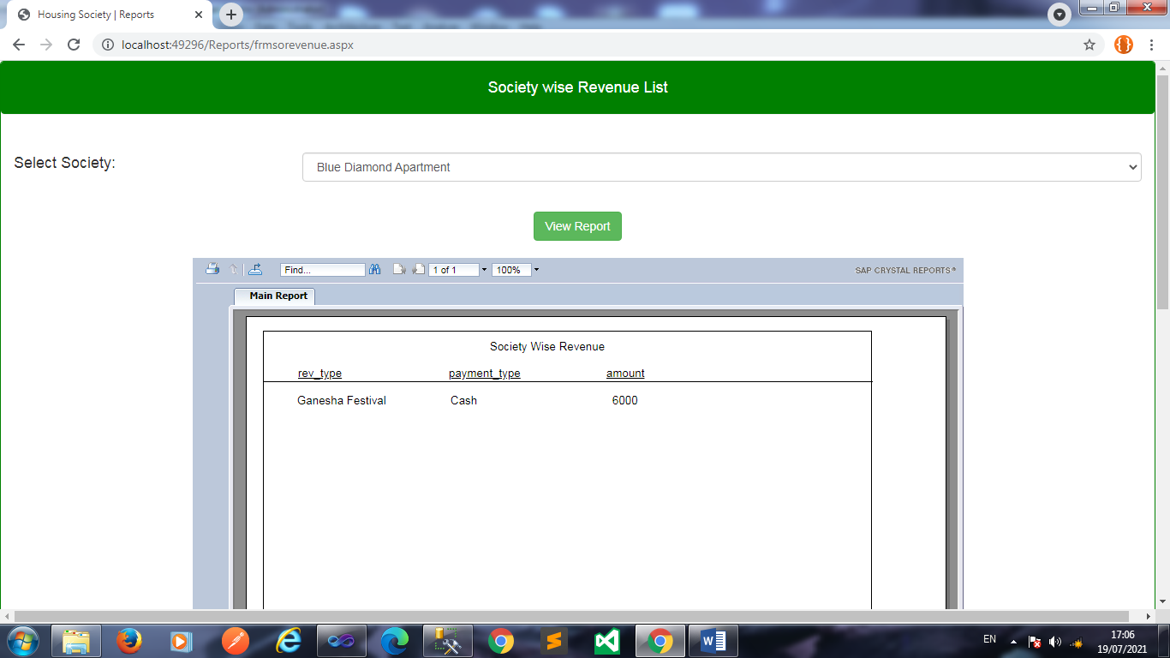
Society wise Revenue Report

Slide 58
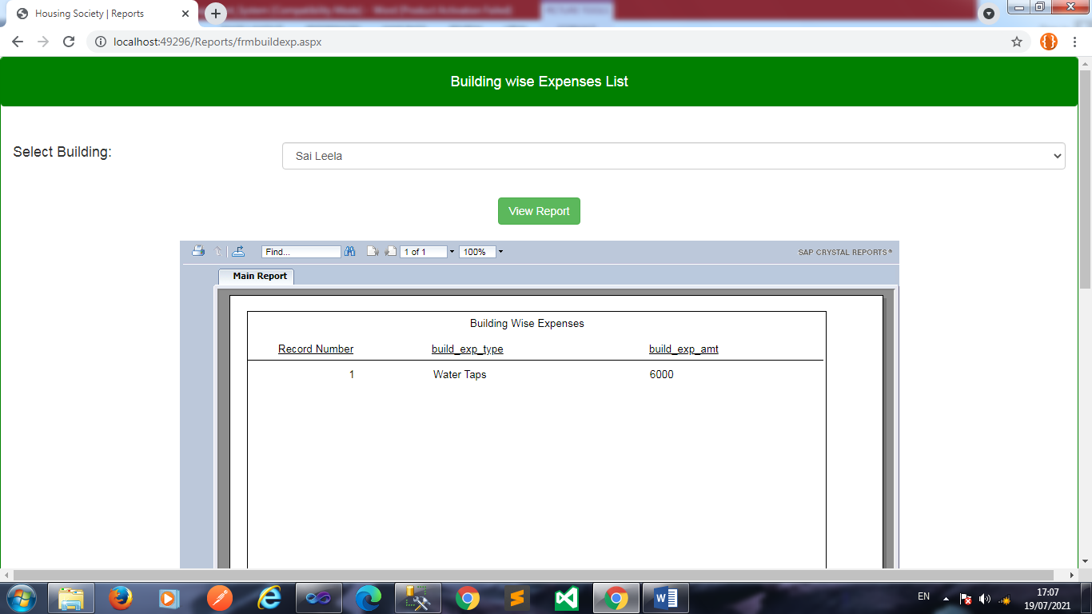
Building wise Expenses Report

Slide 59
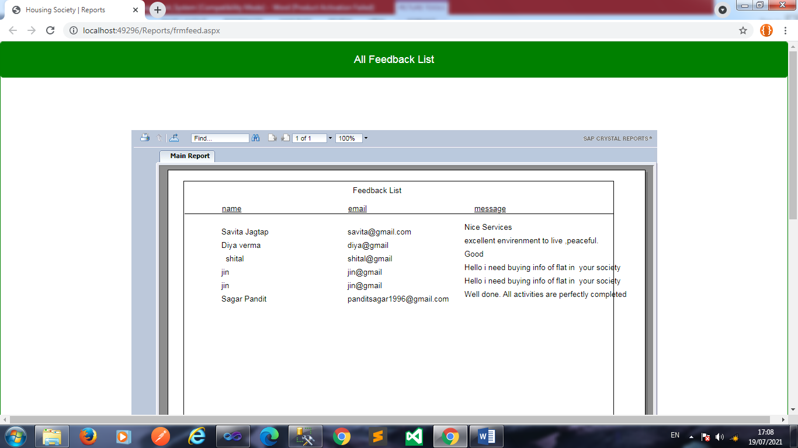
View Feedback :

Slide 60
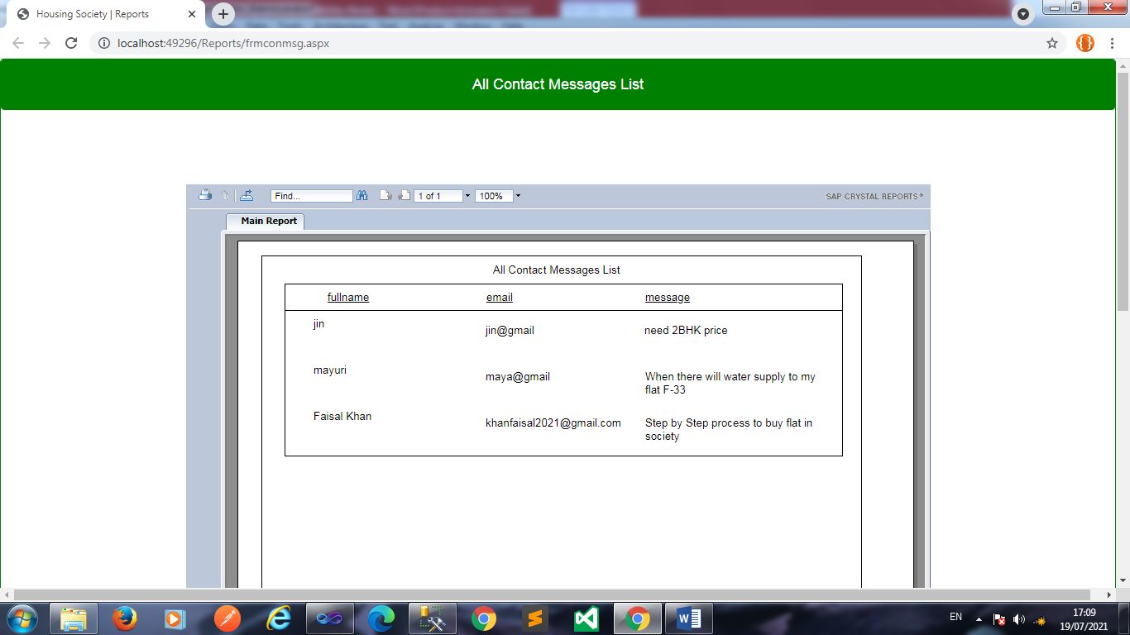
View Contact Message :

Slide 61
Drawbacks & Limitations
Drawbacks
Major efforts have been taken to complete this system but still it has some drawbacks which are not overcome yet.
Help and facility information about the system would be insufficient .
Limitations:
This system has following limitations
The backend technology if changed at some alter time may consume much time to get implemented.
The users of the system can not communicate online to each other.

Slide 62
Future Enhancements
System must provide online interactive Help.
System should be provide online communication between users.

Slide 63
Conclusion
Society management system puts forth the actual working of a society. Administration, working, etc. similar to a society are the key features of our project. User can access feeds and news from the society anywhere and anytime for their own comfort.

Slide 64
Thank You!!

